Slide 1

Question Answering
Submitted by:
Amit Dutta – 21166028
A.A.Noman Ansary – 18301147
Adib Muhammad Amit – 19101657
Saif Shahnewaz Saad – 16101181
Submitting to:
Annajiat Alim Rasel
Senior Lecturer, CSE Department
BRAC University

Slide 2
Introduction:
“Question Answering” is a discipline within the fields of IR and NLP
This discipline concerns itself with building systems that automatically answers questions
These systems answers questions which is generic to a natural language.
In short, this is a human-machine interaction to extract information from data using natural language queries.
This system can be designed in many different ways but mainly it depends on 3 key steps
They are: knowledge bestowed to the system, types of question the system can answer and the structure of data supporting the system.

Slide 3
Information Retrieval
The field encompassing the retrieval of all manner of media based on user information requirement.
Ad hoc retrieval(an IR task), is the task of returning information resources related to a user query formulated in natural language.
A document refers to whatever unit of text the system indexes and retrieves
A collection refers to a set of documents being used to satisfy user requests
A term refers to a word in a collection.
A query represents a user’s information need expressed as a set of terms.

Slide 4
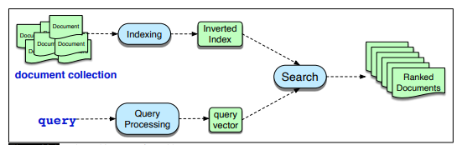
The architecture of an ad hoc IR system

Slide 5
Term weighting and document scoring
Raw word counts in IR is not used, instead a term weight for each document word is computed.
Two term weighting schemes are: tf-idf weighting and a slightly more powerful variant known as BM25.
tf or term frequency tells you how frequent a word is; which occurs more often in the document and likely to be informative about the documents content.
tf= log10(count(t , d)+1)
df is the document frequency for a term t, the number of documents it occurs in. IDF or inverse document frequency is defined as:
Idf =log10(N/df)

Slide 6
IR based Factoid Question Answering
The goal of IR based QA is to answer users question
By means of finding short text segments from web or some other large collection of documents.
The dominant paradigm for IR based QA is the retrieve and read model
Datasets for IR-based QA are most commonly created by first developing reading comprehension datasets containing tuples of (passage, question, answer)
There are 2 stages to IR based QA
The first stage is a retriever and the second stage is the reader.

Slide 7
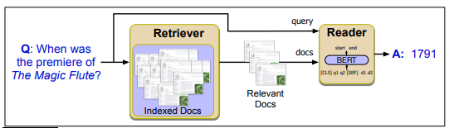
IR based factoid question answering

Slide 8
Entity Linking
It is the task of associating a mention in text with the representation of some real-world entity in an ontology.
Entity linking is done in 2 stages
The 1st stage is: mention detection(detects mentions by querying the anchor dictionary for each token sequence up to 6 words)
The 2nd stage is : mention disambiguation(uses 2 factors for disambiguating ambiguous spans )

Slide 9
Knowledge based QA
The idea of answering a natural language question by mapping it to a query over a structured database.
Two common paradigms are used for knowledge based QA
The paradigms are: (1) Graph based QA and (2)QA by semantic parsing
Both of these methods require some sort of entity linking that was mention in one of the previous slides.

Slide 10
Using Language Model to do QA
An alternative to doing QA
This method is executed by querying a pre-trained language model
Forcing the language model to answer a question solely from the information stored within its parameters.
An example would be the T5 language model, which is an encoder-decoder architecture pre-trained to fill in masked spans of task.
Although this is an alternative, language modeling is not yet a complete solution for question answering.

Slide 11
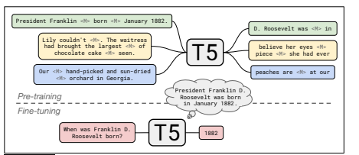
The T5 is an encoder-decoder architecture

Slide 12
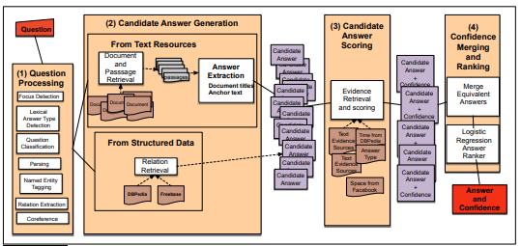
Classic QA Models
Watson Deep QA system from IBM (won the game show jeopardy)
Deep QA
The 4 broad stages of Watson QA form IBM

Slide 13

Evaluation of Factoid Answers
A common evaluation metric for factoid question answering is mean reciprocal rank or MRR
MRR assumes a test set of questions that have been human labeled with correct answers.
It also assumes the systems returning a short ranked list of answers or passages containing answers.
Each question is then scored according to the reciprocal of the rank of the first correct answer.
MRR can be defined as:

Slide 14


